Slide 1

Six munths ago
I cudnt evun spelt chemissed.
An now I are one.

Slide 2
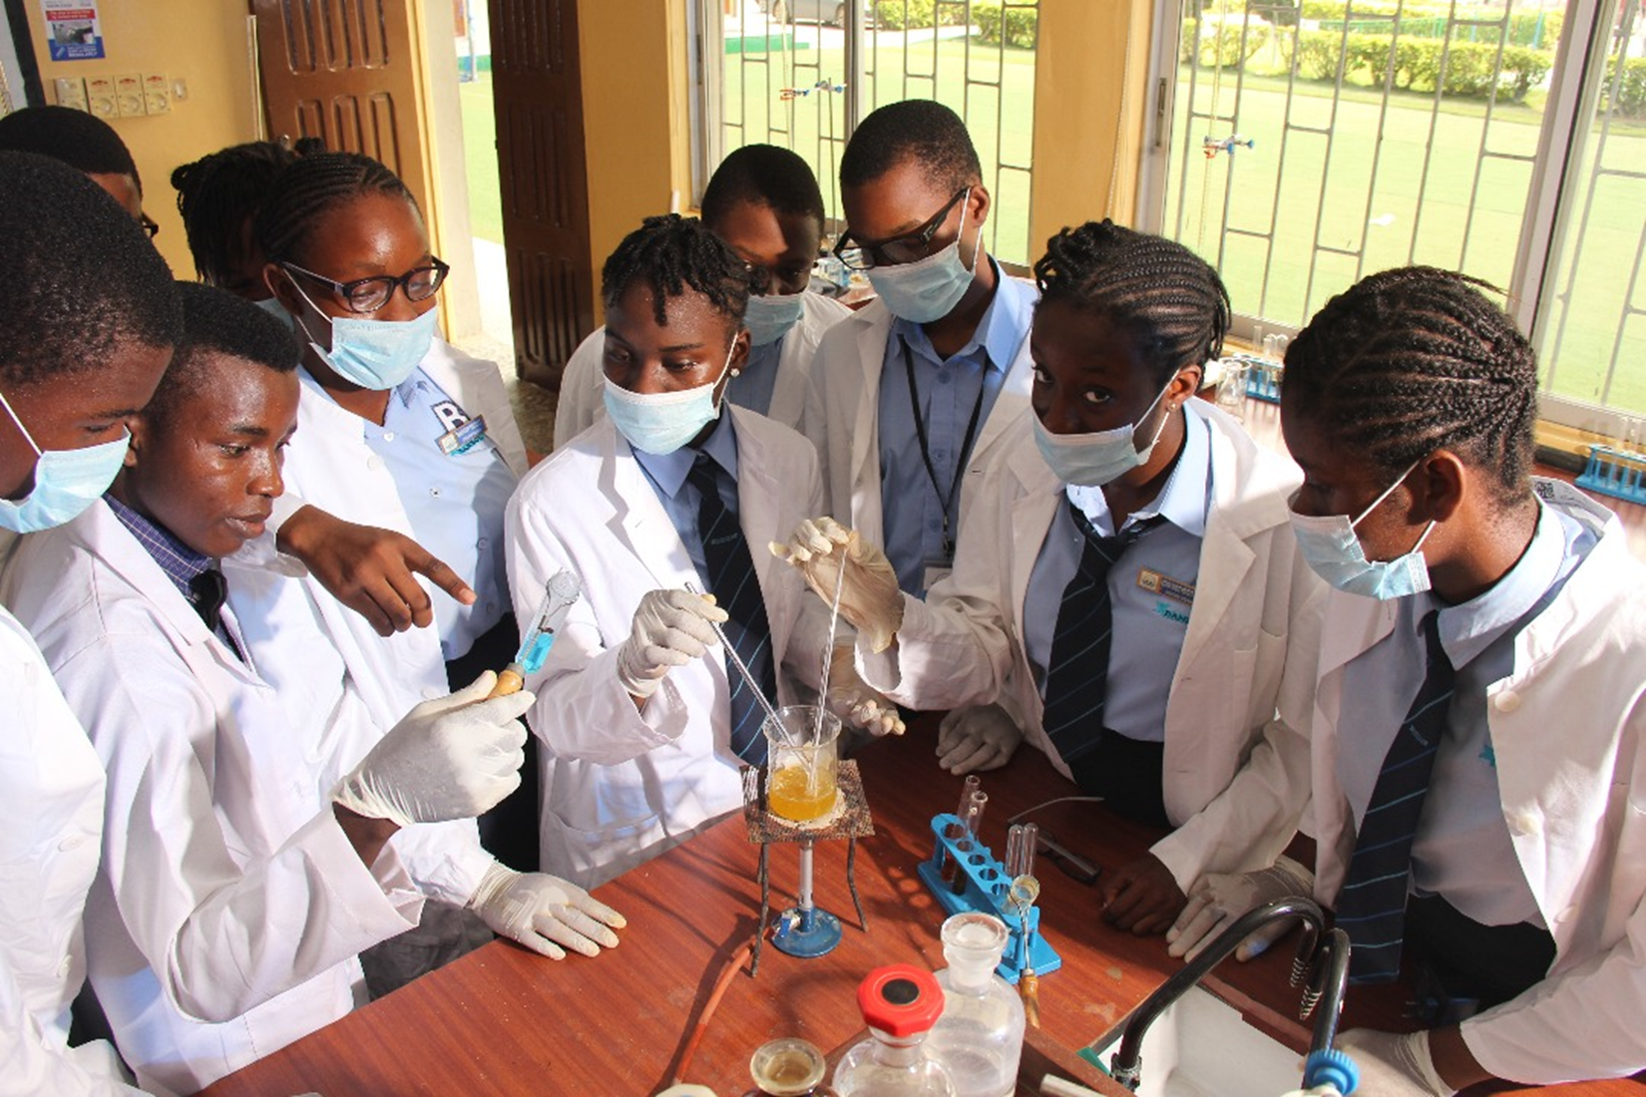
WHAT IS CHEMISTRY?
WELCOME TO CHEMISTRY CLASS
CHEMISTRY IS LIFE
CHEMISTRY IS FUN

Slide 3
SS1 CHEMISTRY
SCHEME OF WORK

Slide 4
Scheme of work for first term
WEEK | TOPIC
1. | Introduction to chemistry
2 | Nature of matter
3 | Elements
4 | Elements
5 | Particulate nature of matter
6 | Relative atomic masses of elements
7 | Compounds
8 | IUPAC nomenclature of chemical compounds
9 | Mixture
10 | Practical on separation of mixture
11-13 | Revision and Examination

Slide 5
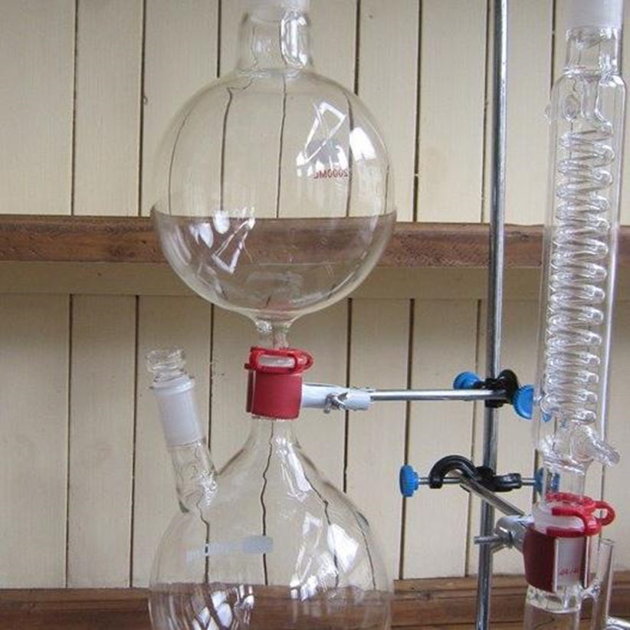
Learning Outcomes
At the end of the lesson, you should be able to:
- Define chemistry and list branches of chemistry;
- State the importance of chemistry;
- List uses of chemistry
- Mention adverse effects of chemistry;
- Mention possible careers in chemistry

Slide 6
Introduction: WHAT IS CHEMISTRY
Chemistry is the study of the composition, properties and uses of matter.
Matter is anything that has mass and occupies space.
The branches of chemistry include:
Physical, Organic, Analytical, Inorganic, Environmental, Industrial and Pharmaceutical e.t.c.
Why do we study chemistry?
We study chemistry :
to acquire knowledge about matter;
to acquire scientific knowledge and training in scientific method;
to have training in handling and manipulating scientific equipment.

Slide 7
Uses of Chemistry:
Chemistry has contributed greatly towards providing:
Food e.g.., production of fertilizer and insecticides;
Clothing e.g.., production of fibers, dyes and processing of wool;
Military hardware and ammunition;
Housing e.g.., production of cements, paints, adhesives, tiles, steel bricks etc..
Medicine e.g.., research, production of wide range of drugs, syringe etc..
Careers in Chemistry:
Many job opportunities are available for students with knowledge of chemistry which include:
Teaching service; Health service; Food processing; Manufacturing industry; Petroleum and petrochemical industries; Agriculture and Forestry.

Slide 8
Adverse effects of chemistry
Chemical processes and products have also affected our life adversely such as:
corrosion of iron;
pollution;
drug abuse.
SCIENTIFIC PROCESSES OF KNOWLEDGE
Make an Observation
Form a Hypothesis
Research
Experiment
Analyze the Data and
Draw a Conclusion

Slide 9
Assignment 1
State two ADVERSE EFFECTS of chemistry AND EXPLAIN WHY

Slide 10
CHEMISTRY APPARATUS AND USES

Slide 13
Assignment 2 20 marks
Draw 15 laboratory apparatus and state their uses
NOTE: THEY MUST NOT BE SAME AS THE ONE’S STATED IN YOUR NOTE.

Slide 14
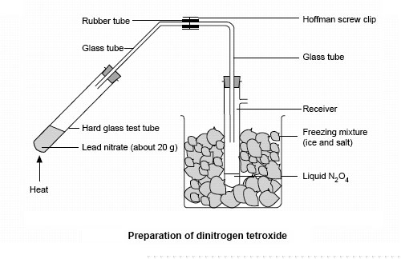
WEEK TWO: NATURE OF MATTER
Learning Outcomes: Students should be able to:
- define matter;
- mention and identify states of matter;
- mention properties of matter;
- define physical and chemical changes;
- list differences between physical and chemical changes.

Slide 15
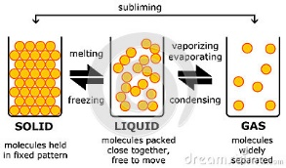
TOPIC: NATURE OF MATTER
What is matter?
Matter is anything that has mass and occupies space.
Almost everything in the universe is made up of matter. Matter is built up from one or more of the following simpler particles: atoms, molecules and ions.
States OF MATTER
There are three states of matter
Solid
Liquid and
Gases

Slide 16
Gas
Boiling
Condensation
Liquid
Sublimation
Melting
Freezing
Solid

Slide 17
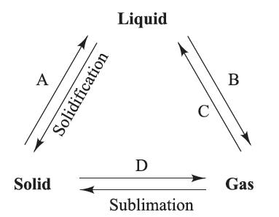
Assignment 3
State the name of each change of state lettered A, B, C and D

Slide 18
COMPARISON BETWEEN STATES OF MATTER
Solid | Liquid | Gases
Solids have definite volume and shape | Liquids have no fixed shape but assumes the shape of the container, it has a fixed volume | Gases have no fixed volume nor shape
Cohesive Force of attraction is high | Weak force of attraction | Negligible force of attraction (very weak)
Type of motion is vibratory | Slowly slide over each other randomly | Fast movement in random direction
Low kinetic energy | Moderate kinetic energy | High kinetic energy
Cannot be compressed | Can be hardly compressed | Very compressible

Slide 19
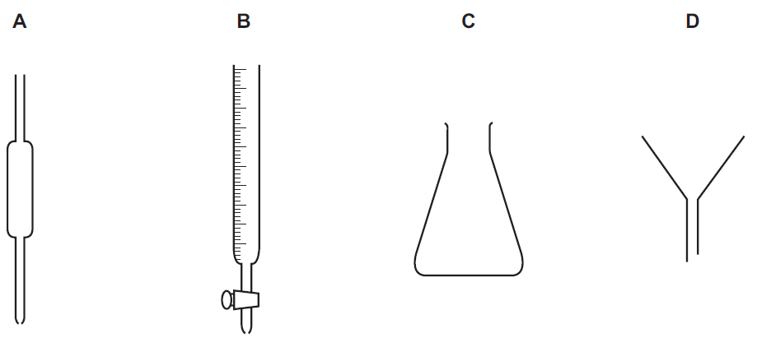
CLASSWORK
Arrange the states of matter in order of:
Decreasing intermolecular force of attraction
Increasing kinetic energy
2
State the name of each of these pieces of apparatus.
A .................................................................B .................................................................
C .................................................................D .................................................................

Slide 20
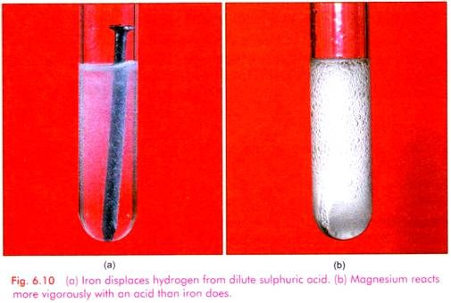
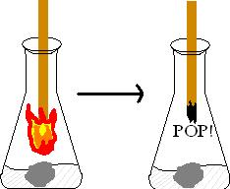
Properties of matter.
Matter can be characterized by its attributes that distinguish it from other types of matter.
Physical Properties:
These are properties that are associated with physical changes e.g.., change of state, density, color, melting and boiling points, malleability etc..
Chemical Properties:
These are properties involved when a substance changes to new substance e.g.., burning of substances in air(combustion), rusting of iron (oxidation), dissolution of metals in acids (displacement)

Slide 21
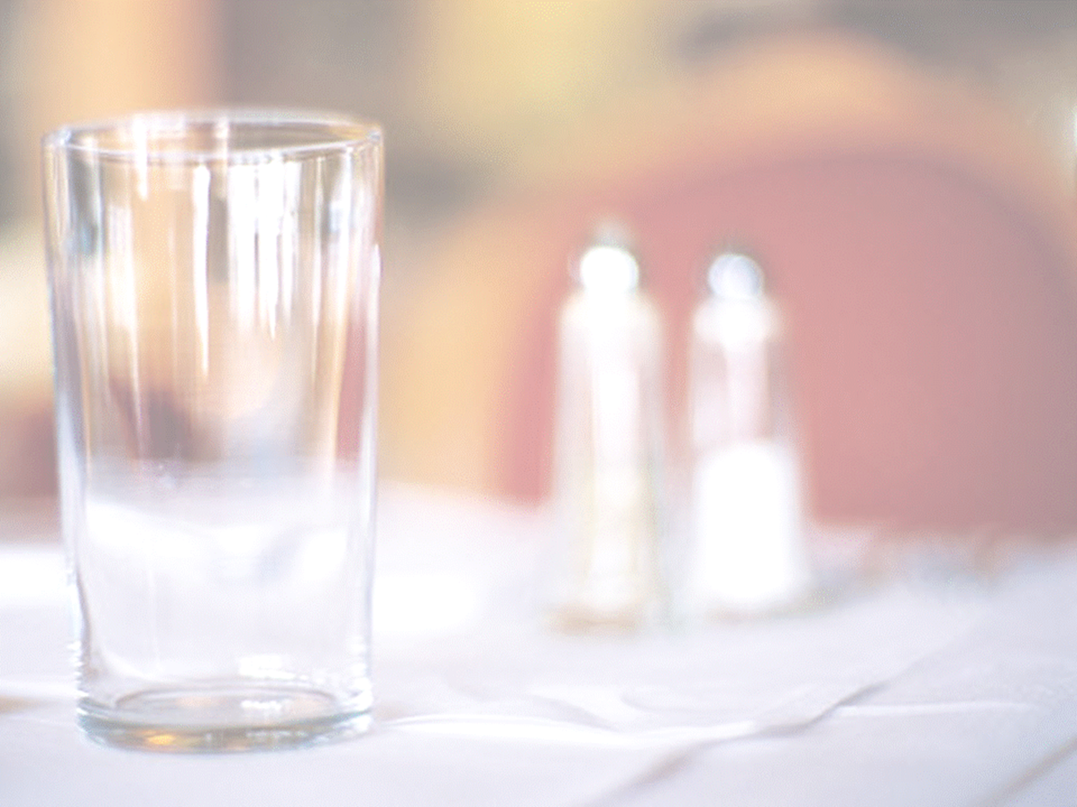
Types of change
Physical and Chemical changes:
Physical Change: This is the type of change in which no new substance is formed and which is easily reversed. Examples are:
- change of states e.g.., melting, freezing, evaporation, the heating of a metal wire by electricity, etc.
Separation of mixtures by physical methods e.g. sieving, chromatography, distillation etc..
Magnetization and demagnetization of Iron fillings

Slide 22
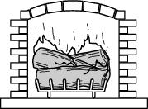


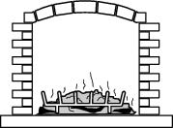
Which picture shows only a physical change in the wood?

Slide 23
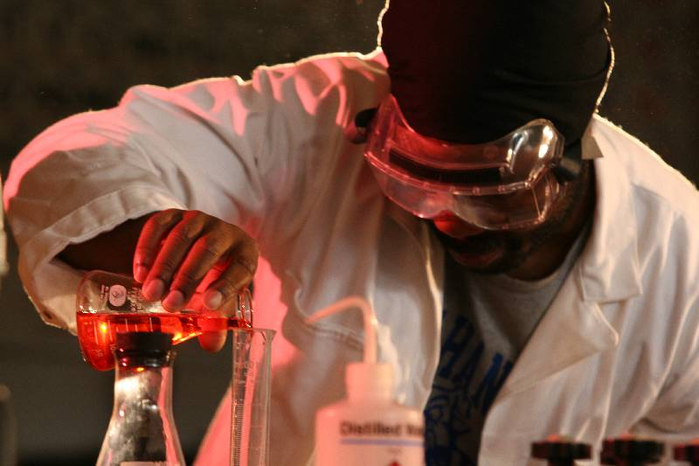
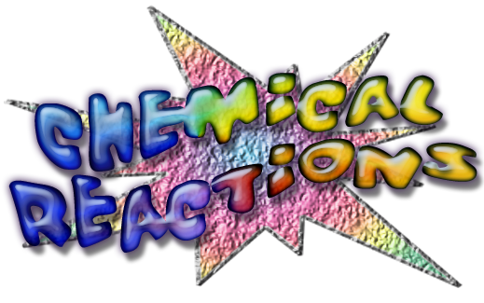

Slide 24
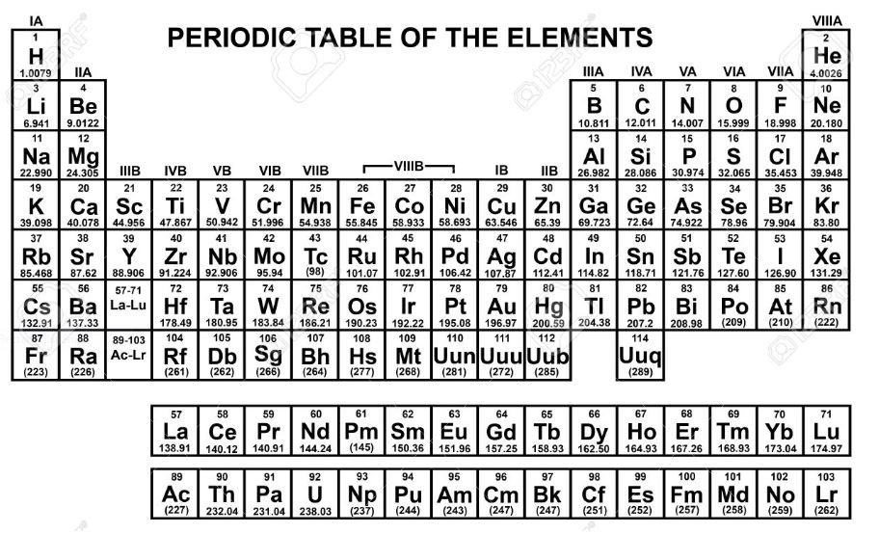

Slide 25

Chemical Change: This is the type of change in which new substance(s) is formed and which is not easily reversed.
Examples are:
- burning of any substance in air;
- the rusting of iron; III. Slaking of lime
IV. Reaction of active metals with water
V. explosion of natural gas with air.
Differences between Physical and Chemical changes
Physical change | Chemical Change
It is easily reversed | It is not easily reversed
No new substances are formed | New substances are formed
There is no change in mass of substances formed | There is change in mass of substances involved
It does not involve great heat changes | It involve great heat changes

Slide 26

evidence of Chemical Change:
development of a gas
formation of precipitate
change in color

Slide 27

Class activity/Responses required
Which is an example of a chemical change?
ice melting
salt crystals being ground to powder
water evaporating
wood burning

Slide 28
Assignment 4
1. Classify each of the following changes into physical or chemical change
Melting of candle wax
Dissolution of common salt in water
Addition of water to lime
Dissolution of copper in dilute acid
Hardening of cement
Burning of wood
2. State 2 differences between physical and chemical change marks

Slide 29
Week 3 ELEMENTS
An element is a substance which cannot be split into two or more simpler units by any known chemical process
Example of elements are: Oxygen, Lead, Nitrogen, Sulphur, Copper, Platinum, Gold, Silver etc.
There are about 118 known elements.
Classification of elements
Elements are classified into
Metals
Non-metals
Metalloids
Metalloids are elements that share the properties of metals and non-metals
Elements are further classified into states of matter

Slide 30
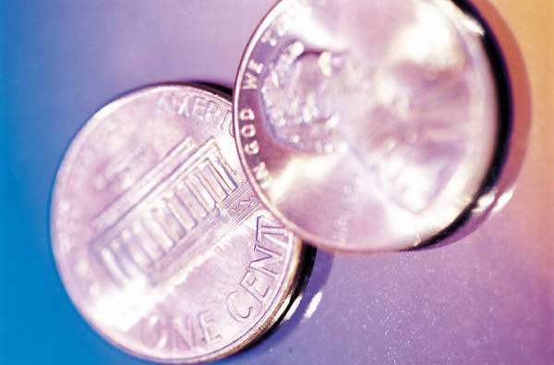
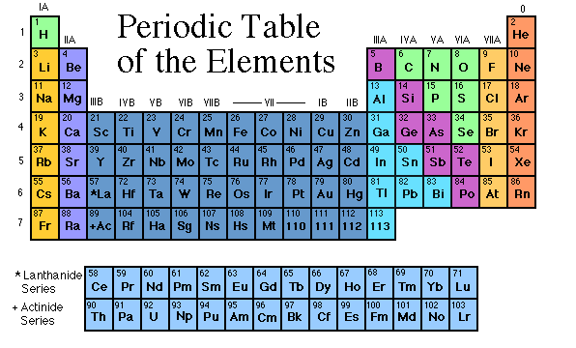


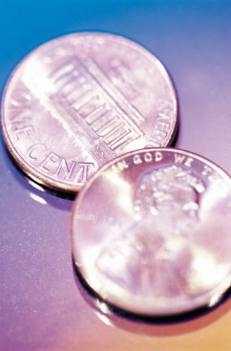
Dense
Shiny
Ductile
Metals
Extra electrons
Conductive
Malleable
Just think

Slide 31
Non-Metals
missing electrons
Non-Conductive
NOT Malleable
Dull
Amazing chemistry

Slide 32
Metalloids
Partly conductive

Slide 33
Physical Property: | Metals | Non-Metals
State In Room Temperature | Solid (Except Mercury, Liquid) | Gas (Except Bromine, Liquid while Iodine is solid)
Density | Very Dense (Except Group 1) | Low Density
Appearance | Shiny, Most Are Grey Except Copper And Gold | Most Are Dull (Except Diamond
Melting Point | High (Except Groups 1 & 2) | Low (Except Diamond-Graphite)
Boiling Point | High (Except Groups 1 & 2) | Low (Except Diamond-Graphite)
Malleability | Hard And Malleable | Soft And Brittle
Ductility | Ductile( ability to be drawn into thin wire) | Not Ductile
Electrical and thermal Conductivity | Good Conductors of heat and electricity | Poor Conductors of heat and electricity (Except Graphite-Silicon)
Sonority | Sonorous | Non-Sonorous

Slide 34
First twenty elements and their symbols
S/No | Name | Symbol
1 | Hydrogen | H
2 | Helium | He
3 | Lithium | Li
4 | Beryllium | Be
5 | Boron | B
6 | Carbon | C
7 | Nitrogen | N
8 | Oxygen | O
9 | Fluorine | F
10 | Neon | Ne
11 | Sodium | Na
12 | Magnesium | Mg
13 | Aluminium | Al
14 | Silicon | Si
15 | Phosphorus | P
16 | Sulphur | S
17 | Chlorine | Cl
18 | Argon | Ar
19 | Potassium | K
20 | Calcium | Ca
Other Elements and their symbols
S/No | Name | Symbol
 | Copper | Cu
 | Silver | Ag
 | Mercury | Hg
 | Gold | Au
 | Tin | Sn
 | Tungsten | W
 | Manganese | Mn
 | Iron | Fe

Slide 35
ATOMS
An atom is the smallest particle of an element which can take part in a chemical reaction. Atoms retain the chemical properties of an element.
All elements are made up of atoms.
Atoms are made up of particles such as protons, electrons and neutrons.
The number of protons or electrons in an atom is called atomic number.
Molecules
A molecule is the smallest particle of a substance that can normally exist alone and still retain the chemical properties of that substance be it an element or a compound.
Combination of two or more atoms of the same element make a molecule.
Atomicity. This is the number of atoms in a molecule of an element.

Slide 36
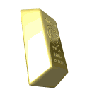
What is the smallest particle of the element gold (Au) that can still be classified as gold?
atom
molecule
neutron
proton
Class Activity

Slide 37
Class of elements
Monoatomic. One atom makes a molecule. Most metals are monoatomic
Diatomic: Two atoms make a molecule. e.g. gases. H₂, Cl₂, Br₂, O₂, N₂
Triatomic: Three atoms make a molecule e.g.. Ozone O₃
ELEMENT | FORMULAR OF MOLECULE | ATOMICITY
Sodium | Na | 1 MONOATOMIC
Neon | Ne | 1 MONOATOMIC
Hydrogen | H2 | 2 DIATOMIC
Oxygen | O2 | 2 DIATOMIC
Chlorine | Cl2 | 2 DIATOMIC
Ozone | O3 | 3 TRI ATOMIC
Phosphorus | P4 | 4 TETRA-ATOMIC
Iodine | I2 | DIATOMIC
Sulphur | S8 | 8 POLYATOMIC

Slide 38
Dalton’s Atomic Theory.
All elements are made up of small indivisible particles called atoms.
Atoms can neither be created nor destroyed.
Atoms of the same elements are alike in every aspect, and can differ from atoms of all other elements.
When atoms combine with other atoms, they do so in simple ratios.
All chemical changes result from the combination or separation of atoms.
The above law was partially supported by evidences deduced from the law of conservation of mass, law of definite proportions, law of multiple proportions etc..

Slide 39
Modification Of Dalton’s Atomic Theory
All elements are made up of small indivisible particles- the atom is made (built) up of three main types of sub-particles i.e. the proton, electron and neutron.
During nuclear reactions, the nucleus is broken up into smaller units which form simpler atoms while tremendous amount of heat energy is released.
Atoms of the same elements are alike in every aspect, and can differ from atoms of all other elements ;- The discovery of isotopes makes the above statement unacceptable.
The statement is generally true only for inorganic compounds which contain a few atoms per molecule unlike organic compounds.

Slide 40
PARTICULATE NATURE OF MATTER.
WEEK 5
Structure of an atom.
An atom has two main parts; the nucleus and shells which surround the nucleus at definite distances.
An atom is made up of Protons, Electrons and Neutrons (P.E.N.)
The protons and neutrons are found in the nucleus while the electrons are constantly revolving round the shells.
Constituents of the atom:
Atoms are themselves built up from smaller particles, three of which are: protons, neutrons and electrons.
Properties of subatomic particles:
Atomic particles | Location | Charge | mass
Proton (p) | Nucleus | Positive (+) | 1
Electron (e) | Outside/shells | Negative (-) | 1/1842 or 0.0005 negligible
Neutron (n) | Nucleus | Nil or zero | 1

Slide 41
Proton Neutron Electron
Electron shell / Electron cloud
Nucleus
The Atom

Slide 42
assignment
Draw the structure of an atom and label it fully
State 3 differences between protons and electrons

Slide 43
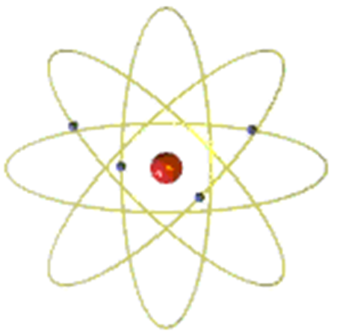
Atomic theories
According to Rutherford nuclear theory, the neutron and proton make up the nucleus of an atom and these are collectively called NUCLEONS
Rutherford theory proposed that the nucleus is positively charged and surrounded by electrons in an orbital manner.
He deduced that the atom consists of a positive core called the nucleus, where most of the mass of the atom is contained and electrons which move around the nucleus.
J.J. Thompson discovered electrons and protons. He proposed that an atom is a sphere of positively charged matter in which negatively electrons are embedded.
R. A Millikan discovered the charge of electrons during his oil droplet experiment
James Chadwick discovered neutrons

Slide 44
Arrangement of Electrons in Atoms
Electronic Configuration
Electronic configuration of an element is the arrangement of electrons of the atom of the element in various energy levels.
Electrons in atoms are arranged as
LEVELS (n)
SUBLEVELS (l)
ORBITALS (m_{l})

Slide 45
QUANTUM NUMBERS
The shape, size, and energy of each orbital is a function of 3 quantum numbers which describe the location of an electron within an atom or ion
Types of Quantum numbers
n principal Quantum numbers ---> energy level
l (Azimuthal or subsidiary Quantum numbers ---> shape of orbital
m_{l} (magnetic Quantum numbers ---> designates a particular suborbital
The fourth quantum number is not derived from the wave function
s (spin Quantum numbers ---> spin of the electron (clockwise or counterclockwise: ½ or – ½)

Slide 46
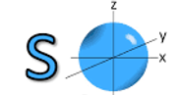
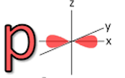
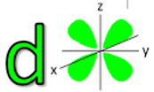
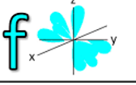
Types of Orbitals and shapes
Types of Orbital | Shape | Maximum number of electrons | Number of sub orbital
S-orbital | Spherical | 2 | 1
P-orbital | Dumbbell | 6 | 3
D-orbital | Double dumbbell | 10 | 5
F orbital | diffused | 14 | 7

Slide 47
4th Shell of electrons
2 6 10 14
s orbital p orbital d orbital f orbital

Slide 48
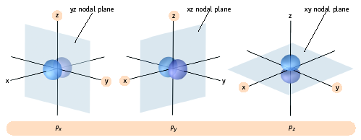
p Orbitals
The three p orbitals lie 90º apart in space

Slide 49

Sequence of filling electron into orbitals Diagonal Rule
1
2
3
4
5s
s
Steps:
Write the energy levels top to bottom.
Write the orbitals in s, p, d, f order. Write the same number of orbitals as the energy level.
Draw diagonal lines from the top right to the bottom left.
To get the correct order, follow the arrows!
s 2p
s 3p 3d
s 4p 4d 4f
(1s 2s 2p 3s 3p 4s 3d 4p)

Slide 50
Examples
Write the electron configuration for the following elements:
₆C =
₁₁Na =
₁₇Cl =
₂₅ Mn =
₁₀Ne =

Slide 51
classwork
Write the electron configuration for the following elements:
₁H
₃Li
₇N
₁₉K
₃₀Zn

Slide 52
Rules guiding electron arrangement into orbitals
Hunds’ Rule
Aufbau’s principle
Pauli’s Exclusion principle
Hunds’ rule states that electrons occupy singly before pairing takes place in a degenerate orbital
Aufbau’s principle states that electrons enter into orbitals in order of increasing energy (1s<2s<2p<3s<3p<4s<3d)
Pauli’s exclusion principle states that two electrons of the same atom cannot have the same value for all the four quantum numbers.

Slide 53
Week 6.
Topic: THE RELATIVE ATOMIC MASSES OF ELEMENTS
Objectives
At the end of the lesson, the students should be able to;
Define atomic number
Differentiate between isotopy and isotopes
Calculate the relative atomic mass of an elements

Slide 54
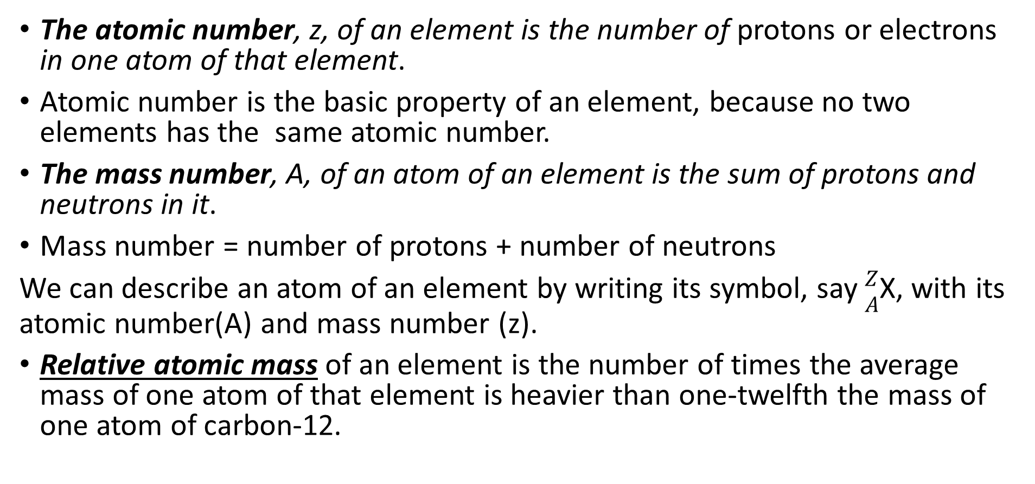
: THE RELATIVE ATOMIC MASSES OF ELEMENTS
The atomic number, z, of an element is the number of protons or electrons in one atom of that element.
Atomic number is the basic property of an element, because no two elements has the same atomic number.
The mass number, A, of an atom of an element is the sum of protons and neutrons in it.
Mass number = number of protons + number of neutrons
We can describe an atom of an element by writing its symbol, say $\begin{matrix}Z \\ A\end{matrix}$X, with its atomic number(A) and mass number (z).
Relative atomic mass of an element is the number of times the average mass of one atom of that element is heavier than one-twelfth the mass of one atom of carbon-12.

Slide 56
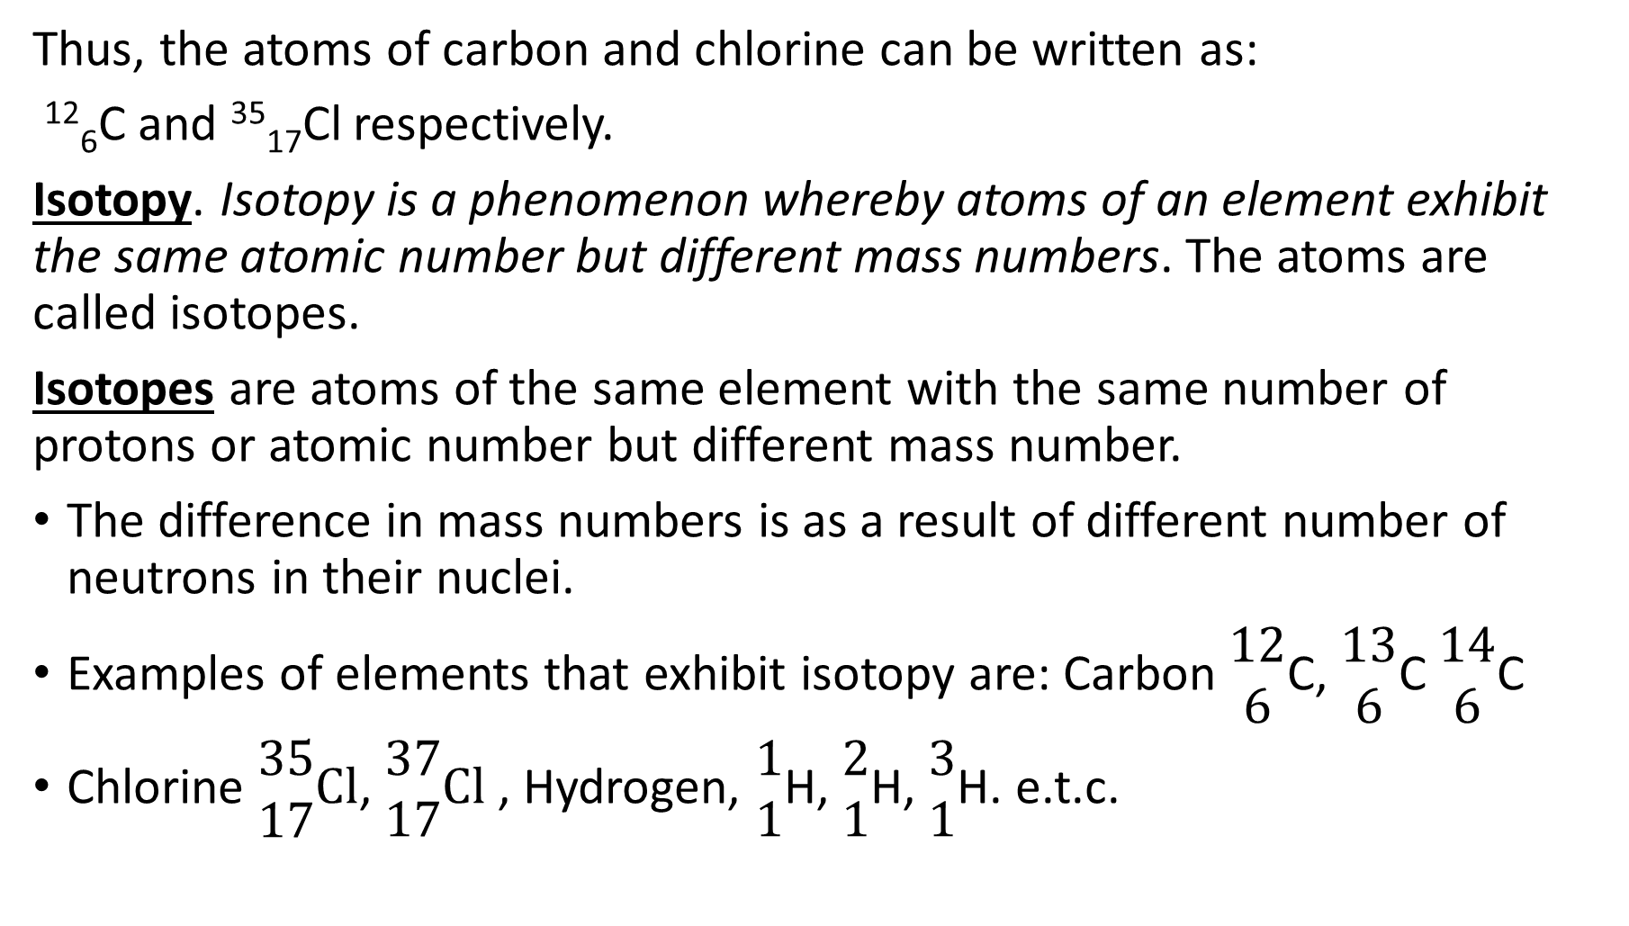
Thus, the atoms of carbon and chlorine can be written as:
¹²₆C and ³⁵₁₇Cl respectively.
Isotopy. Isotopy is a phenomenon whereby atoms of an element exhibit the same atomic number but different mass numbers. The atoms are called isotopes.
Isotopes are atoms of the same element with the same number of protons or atomic number but different mass number.
The difference in mass numbers is as a result of different number of neutrons in their nuclei.
Examples of elements that exhibit isotopy are: Carbon $\begin{matrix}12 \\ 6\end{matrix}$C, $\begin{matrix}13 \\ 6\end{matrix}$C $\begin{matrix}14 \\ 6\end{matrix}$C
Chlorine $\begin{matrix}35 \\ 17\end{matrix}Cl$, $\begin{matrix}37 \\ 17\end{matrix}Cl$ , Hydrogen, $\begin{matrix}1 \\ 1\end{matrix}$H, $\begin{matrix}2 \\ 1\end{matrix}$H, $\begin{matrix}3 \\ 1\end{matrix}$H. e.t.c.

Slide 57

Isotopes
3 2 1
3 2 1
12 6
13 6
C
Legend
Proton
Neutron
Electron
C

Slide 58
Isotopes
Atoms of the same element
(same number of protons) with a different number of neutrons.
H H

Slide 59
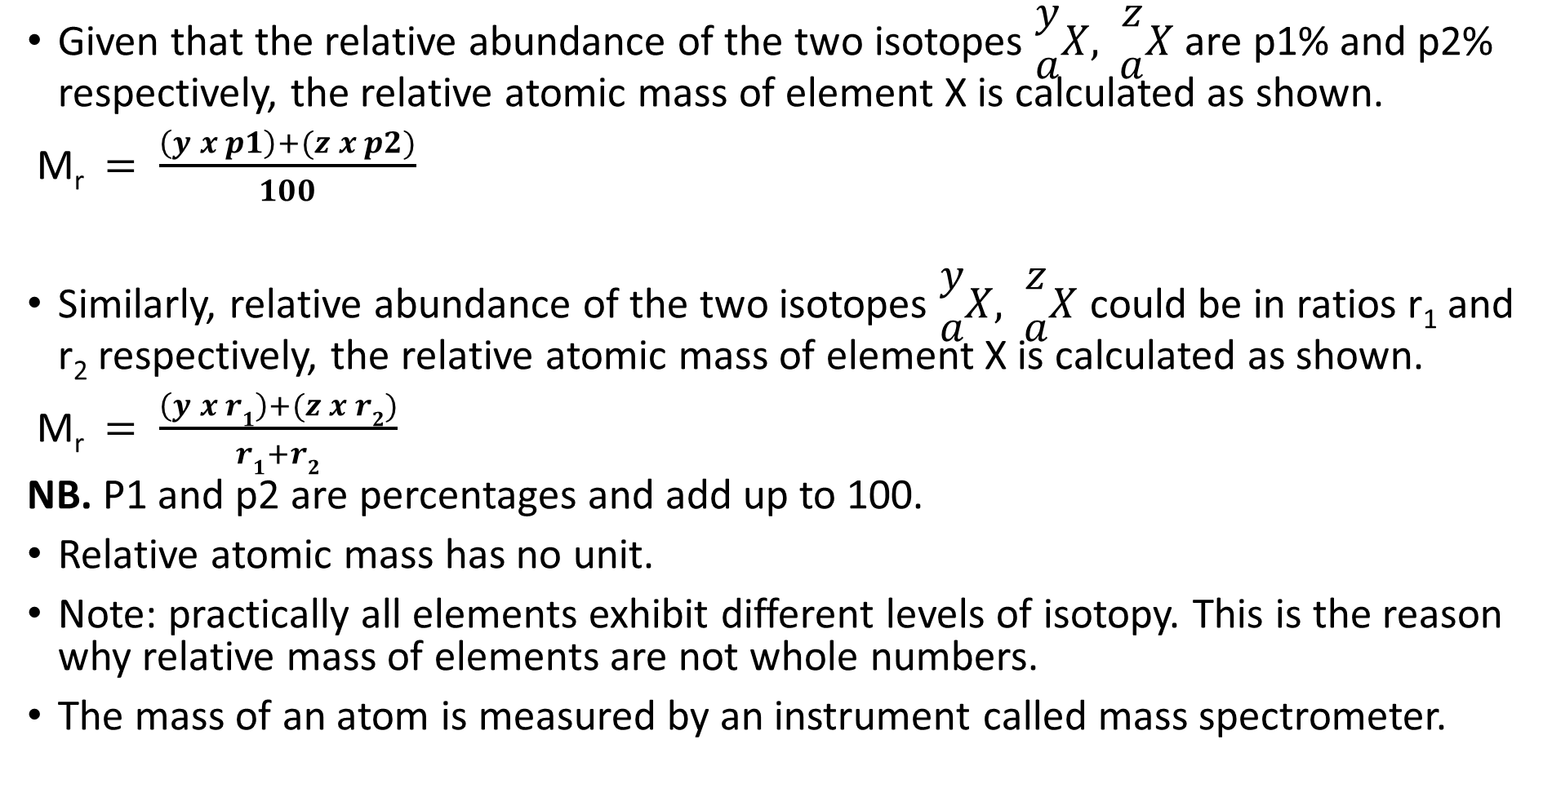
Calculation of Relative atomic mass R.A.M.
Given that the relative abundance of the two isotopes $\begin{matrix}y \\ a\end{matrix}X,$ $\begin{matrix}z \\ a\end{matrix}X$ are p1% and p2% respectively, the relative atomic mass of element X is calculated as shown.
M_{r}$= \frac{\left(y x p1\right)+(z x p2)}{100}$
Similarly, relative abundance of the two isotopes $\begin{matrix}y \\ a\end{matrix}X,$ $\begin{matrix}z \\ a\end{matrix}X$ could be in ratios r₁ and r₂ respectively, the relative atomic mass of element X is calculated as shown.
M_{r}$= \frac{\left(y x r1\right)+(z x r2)}{r1+r2}$
NB. P1 and p2 are percentages and add up to 100.
Relative atomic mass has no unit.
Note: practically all elements exhibit different levels of isotopy. This is the reason why relative mass of elements are not whole numbers.
The mass of an atom is measured by an instrument called mass spectrometer.

Slide 60
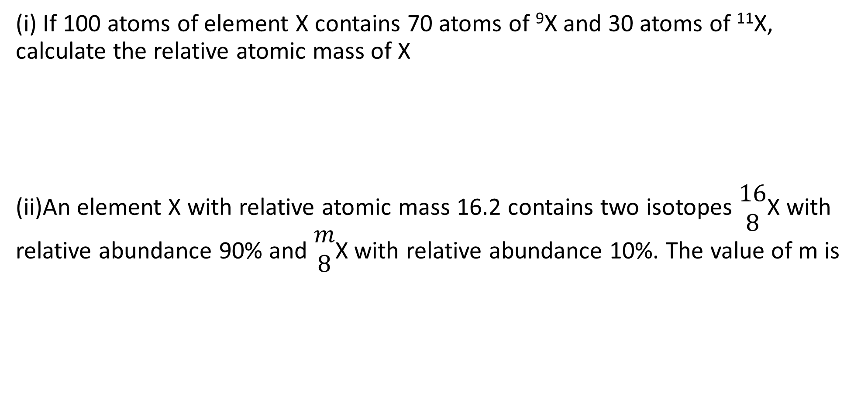
Worked examples
(i) If 100 atoms of element X contains 70 atoms of ⁹X and 30 atoms of ¹¹X, calculate the relative atomic mass of X
(ii)An element X with relative atomic mass 16.2 contains two isotopes $\begin{matrix}16 \\ 8\end{matrix}$X with relative abundance 90% and $\begin{matrix}m \\ 8\end{matrix}$X with relative abundance 10%. The value of m is

Slide 61
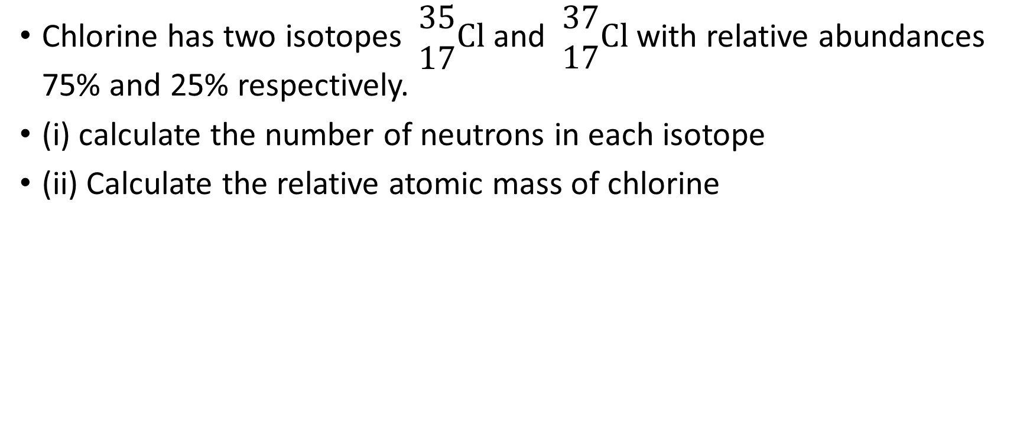
Open test 5 minutes
Chlorine has two isotopes $\begin{matrix}35 \\ 17\end{matrix}Cl$ and $\begin{matrix}37 \\ 17\end{matrix}Cl$ with relative abundances 75% and 25% respectively.
(i) calculate the number of neutrons in each isotope
(ii) Calculate the relative atomic mass of chlorine

Slide 62
Compounds
A compound is a substance which contains two or more elements chemically combined together.
Compounds are made from elements. Simple element like water contains two elements chemically combined with sets of properties that are completely different from those of the constituent elements.
Examples of compounds and their constituents.
Water Oxygen; hydrogen
Sugar(sucrose) Oxygen, carbon, hydrogen.
Sodium chloride. Sodium; chlorine
Marble Calcium; oxygen; carbon.
Clay Aluminum; silicon; oxygen; hydrogen.
Sand Silicon; oxygen

Slide 63
Mixtures:
A mixture is a substance which contains two or more substances that are not chemically combined. Unlike compounds, constituents of a mixture retain their individual properties. This is the reason why constituents of mixtures can be separated by physical methods.
Example of some mixtures and their constituents.
Soil sand, stones, humus, water, air etc.
Blood water, blood cells, dissolved materials.
Sea water water, salt, air, dissolved materials, etc.
Air nitrogen, oxygen, CO₂, water vapour, etc.

Slide 64
Differences between compounds and mixtures.
Mixtures. Compounds.
1. the constituents can be The constituents cannot be separated
separated by physical by physical methods
methods.
2. Mixtures may vary widely They are fixed in composition by mass.
in composition by mass.
3.properties are sum of those properties different from those of the
individual constituents individual constituents.
4. They cannot be represented by They can be represented by chemical formula
chemical formula

Slide 65
Relative Molecular Mass:
The relative molecular mass, M_{r,} of an element or a compound is the number of times the average mass of one molecule of it is heavier than 1/12th, the one atom of carbon-12.
The relative molecular mass of an element or compound is the sum of the relative atomic masses of all atoms in one molecule of that substance.
This is relative molecular mass expressed in gram per mole
Example:
Calculate the relative molecular mass of limestone, CaCO₃. (Ca=40;C=12;O=16).
Solution:
One molecule of CaCO₃ has 1 atom of Ca, 1 atom of C and 3 atoms of O. so,
M_{r}. = (1x 40)+(1x12)+(3x16) = 100gmol⁻¹.
Class work
Calculate the relative molecular mass of the following compounds
(i) NaCl (ii)CuSO₄
(iii) Al₂(SO₄)₃ (iv) Na₂CO₃
[ Na =23, Cu=64, S=32, O=16, Cl =35.5, Al =27 ]

Slide 66
Class work
Calculate the relative molecular mass of the following compounds
NaCl
CuSO₄
Al₂(SO₄)₃
Na₂CO₃
Na =23, Cu=64, S=32, O=16, Cl =35.5, Al =27,

Slide 67
IUPAC NOMENCLATURE OF INORGANIC COMPOUNDS
The IUPAC nomenclature of inorganic chemistry is a systematic method of naming inorganic chemical compounds, as recommended by the International Union of Pure and Applied Chemistry (IUPAC)
Ions: An ion is any atom or group of atoms(radicals) which possesses an electric charge. There are two types of ions:
Cation: an ion with a positive charge.
Anion: an ion with a Negative charge.
H⁺ Hydrogen ion
Na⁺ Sodium ion
Mg⁺² Magnesium ion
Ca⁺² Calcium ion
Ag⁺ Silver ion
Valency : is the combining power of an element. It has no charge and it helps in constructing the formulae of compounds.
Cu⁺ Copper (I) ion
Al⁺³ Aluminium ion
Zn⁺² Zinc ion
Cu⁺² Copper (II) ion
Fe⁺² Iron (II) ion
Fe⁺³ Iron (III) ion

Slide 68
Radicals :These are group of atoms carrying charges that keep their identity and react as a single unit.
Oxidation number of an element is the electrical charge it appears to have both in free and combined states, as determined by a set of rules
Radical IUPAC name
Radical IUPAC name
NO₃⁻ trioxonitrate (V)
NO₂⁻ dioxonitrite (III)
ClO⁻ oxochlorate (1)
ClO₃⁻ trioxochlorate (V)
CrO₄²⁻ tetraoxochromate (VI)
Cr₂O₇²⁻ heptaoxodichromate (VI)
C₂O₄²⁻ oxalate
CN⁻ cyanide
MnO₄⁻ permanganate
ClO₄⁻ perchlorate
HCO₃⁻ hydrogentrioxocarbonate (IV)
CO₃²⁻ trioxocarbonate (IV)
PO₄³⁻ tetraoxophosphate (V)
Cl⁻ chloride
S²⁻ sulfide
P³⁻ phosphide
NH₄⁺ ammonium
H₃O⁺ hydronium
OH⁻ hydroxide
O²⁻ oxide
SO₄²⁻ tetraoxosulphate (VI)

Slide 69
Naming Compounds
Write the formula of the following compounds:
a) Sodium trioxocarbonate (IV) b) Copper (I) oxide
c) Aluminium tetraoxosulphate (VI) d) Copper (II) chloride

Slide 70
Rules for determining oxidation number
All elements in the uncombined state have an oxidation number of Zero e.g. CL₂, Na, P₄ all have oxidation number of zero.
The oxidation number of a simple ion has the same size and sign as the charge of the ion e.g. Zn²⁺ = +2, Ag⁺ = +1
When an ion consists of more than one element, its oxidation number is the sum of the oxidation states of all the elements in the ion e.g. NH₄⁺ i.e.
oxidation no. of N + 4[oxidation no of H] = +1
(-3) + 4(+1) = +1
4. The sum of oxidation numbers of the elements in a compound is zero e.g. NaCl = 0 [Na =+1: Cl = -1] therefore NaCl= Na+Cl = 0
5. The oxidation number of H is +1 except in hydrides where it is -1 and that of oxygen is -2 except in peroxides where it is -1

Slide 72

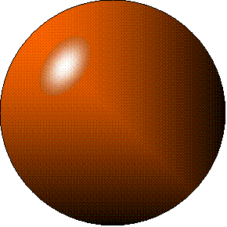
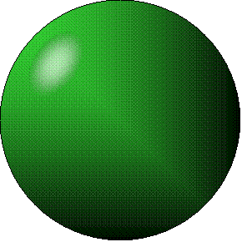
+
Cation
an ion with a positive charge.
Anion
an ion with a Negative charge.
-

Slide 73
Cation
an ion with a positive charge.
H⁺ Hydrogen ion
Na⁺ Sodium ion
Mg⁺² Magnesium ion
Ca⁺² Calcium ion
Ag⁺² Silver ion

Slide 74
Anions
F⁻¹ Fluoride
Cl⁻¹ Chloride
Br⁻¹ Bromide
I⁻¹ Iodide
The Halogens

Slide 75
SEPARATION TECHNIQUES
Learning Outcomes:
- define mixtures;
- mention properties of mixtures;
Mention types of separation techniques and types of mixtures separated by each.

Slide 76
SEPARATION TECHNIQUES
Types of Separation Techniques:
Technique: To separate…
Sieving solids of different sizes.
Sublimation solids which sublime from other solids.
Decantation, insoluble solids from liquids.
Filtration, centrifugation. Separate solid particles from solutions
Evaporation, soluble solid from solution
Crystallization; Obtain solids which are unstable to heat from solution
Fractional crystallization; Solid from a solution
Precipitation. Separating mixtures of different solubilities in a solvent
Distillation solvents from its solution
Fractional distillation miscible liquids of different boiling points
separating funnel separate immiscible liquids.
Chromatography separate mixtures of coloured substances

Slide 77
Evaporation, soluble solid from solution
Crystallization; Obtain solids which are unstable to heat from solution
Fractional crystallization; Solid from a solution
Precipitation. Separating mixtures of different solubilities in a solvent
Distillation solvents from its solution
Fractional distillation miscible liquids of different boiling points
separating funnel separate immiscible liquids.
Chromatography separate mixtures of coloured substances

Slide 78
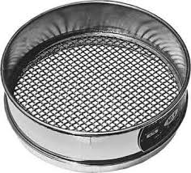
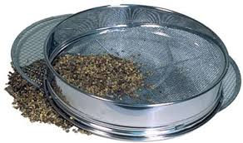
1.Sieving: This method is used to separate solid particles of different sizes.
Apparatus: sieve with a mesh of a particular size.
Procedure: the mixture is placed on the sieve and shake or is stirred.
Result: particles of the size of the sieve pass through the sieve while the bigger particles remain on the sieve.
Industrial application: the method is applied in mining industries, garri industries in West Africa.

Slide 79
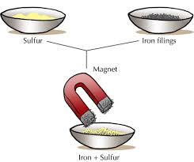
2. Magnetic separation: This is used to separate magnetic substances from non-magnetic particles.
Apparatus: magnetic separator.
Procedure: the mixture is poured on the separator.
Result: magnetic particles are separated from non-magnetic ones.
Application: applied in extraction of iron, tin etc.

Slide 80
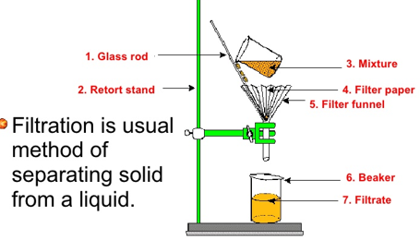
3.Filtration: This method is used to separate insoluble solids from liquids.
Apparatus: funnel, conical flask, filter paper, stirrer, retort stand etc.
Procedure: set up the apparatus as shown in the diagram.
Result: the liquid portion passes through the filter paper as filtrate while the insoluble solid remains on the filter paper as residue.
Application: Water purification, breweries and bottling industries.

Slide 82
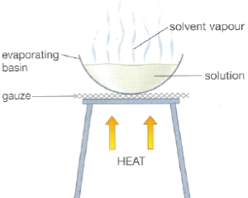
4. Evaporation to dryness: This method is used to recover soluble solute from solution by heating the solution until the solvent dries up.
Apparatus: evaporating dish, tripod stand, Bunsen burner, wire gauze, water/sand bath.
Procedure: put the solution in the evaporating dish. Place the dish on a beaker in which there is some water. Put the beaker with the dish on the tripod stand and heat gently
Result: the liquid portion(solvent) dries up leaving the solid(solute) behind in the dish.
Application: used in salt making.
Note:- this method is not suitable for separating salts(substances) that are easily decomposed(broken down) by heat.
- The water bath brings about steady rate of evaporation.

Slide 83
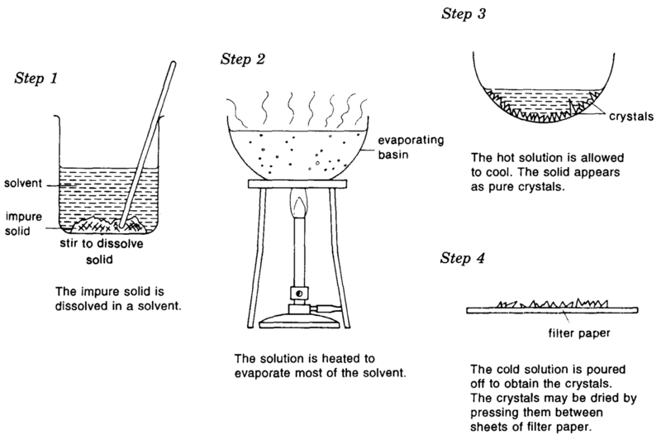
5. Crystallization: crystallization is used to separate salts which decompose easily on heating, from their solutions.
Apparatus: same as for evaporation to dryness.
Procedure: the solution is first heated to evaporate some of the solvent (concentration). The solution becomes saturated. When this is cooled, crystals of the solute begins to form. Filter the crystals and dry between filter paper.

Slide 84
To induce formation of crystals:
- scratch inside of the vessel containing the solution or
- add pure sample of the same salt as seed (seeding).
Result: the salt (solute) crystalizes out and is obtained by filtration.
Application: this method is used in drugs and sugar industries (where purity is very important).
Note: this method produces pure salts, usually with water of crystallization.

Slide 85
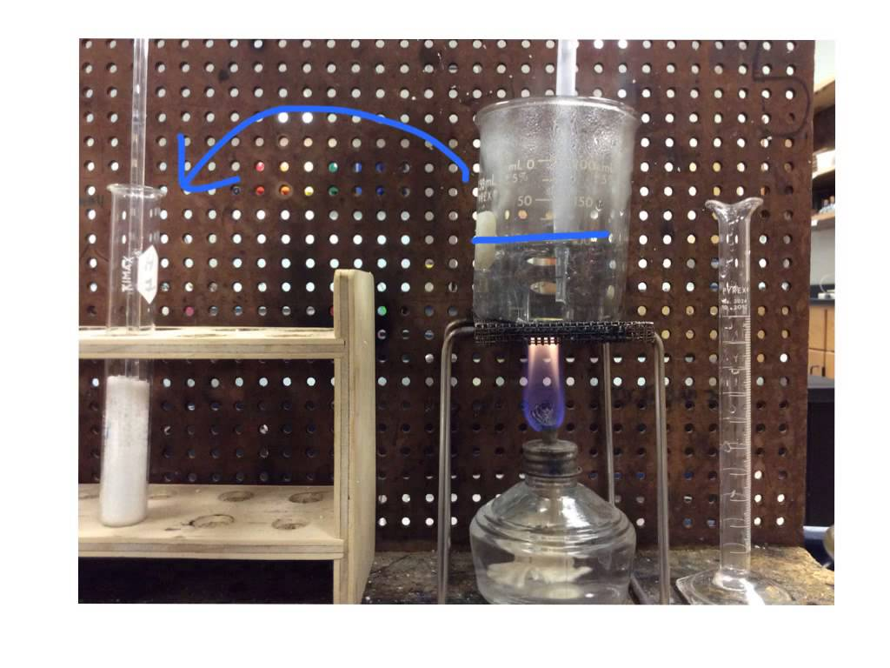
6. Fractional crystallization: This method is used to separate two or more solutes present in the same solution with roughly equal amount.
Procedure: The method is the same as ordinary crystallization. However, since the solutes have different solubility at different temperatures, during cooling, each solute crystallizes out at different temperatures.

Slide 86
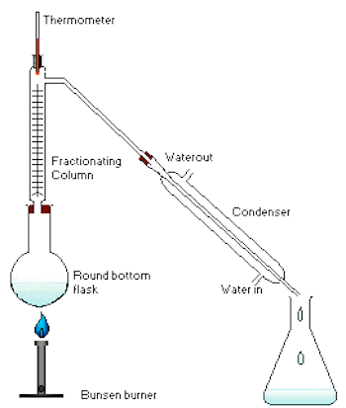
7. Distillation: Simple distillation is best used to obtain a liquid solvent from a liquid solution (miscible).
Procedure: The solution is heated in a distillation flask to which a condenser is attached. The vapour of the liquid
with the lower boiling point vapourises, passes through the condenser and is then converted to liquid again.
Apparatus: distillation flask, Liebig condenser, Bunsen burner, tripod stand, wire gauze, beakers, thermometer.

Slide 88
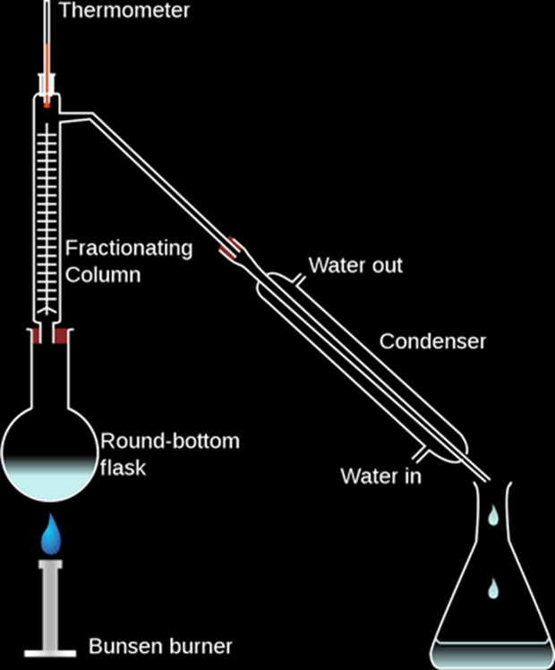
Fractional Distillation (For Miscible Liquids):
Fractional distillation is a method of separating a mixture of two or more liquids provided that they have different boiling points:
Application: It is used in refining crude oil, Separation of air into its components

Slide 90
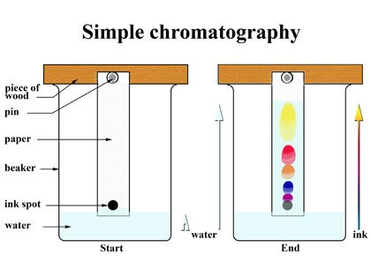
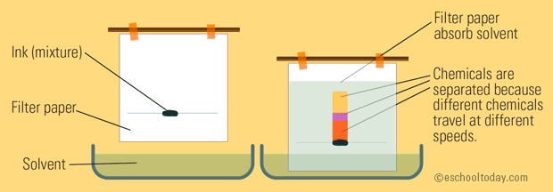
Chromatography: This is the method used to separate complex mixtures especially, colored mixtures.
Types of Chromatography: The types of chromatography are:
Gas chromatography, Column chromatography, Paper chromatography and Thin layer chromatography.
Paper chromatography: This is the simplest type. It is usually used to separate mixture of colored solids e.g.. dye.
Apparatus: piece of filter paper, test tube, split wooden cork, solvent, stationary phase.

Slide 91
Procedure: Introduce a drop of the colored mixture into the slight line with the aid of a capillary tube; allow to dry. Insert the filter paper into a solvent in a boiling tube (the filter paper is held in the split wooden cork which is also used to stopper the tube. Allow to stand for sometime.
Result: As the solvent rises, the components of the solute are carried along the paper (stationary phase). The components are deposited as spots on the paper each depending on its rate of adsorption.
Application: The method is used for complete separation of solute components and chemical analysis.

Slide 92
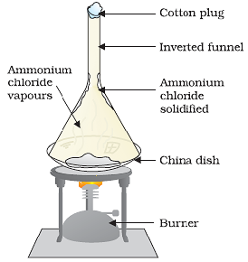
Sublimation
If we have a mixture of two solids, one of them undergoes sublimation we can easily separate them by heating the mixture using a Bunsen burner.
One solid might melt while the other one will directly sublime into a gas. This process must be done in a fume cupboard in order to collect the gas.
Examples of substances that sublime are: ammonium chloride, Iodine, Camphor

